Slide 1

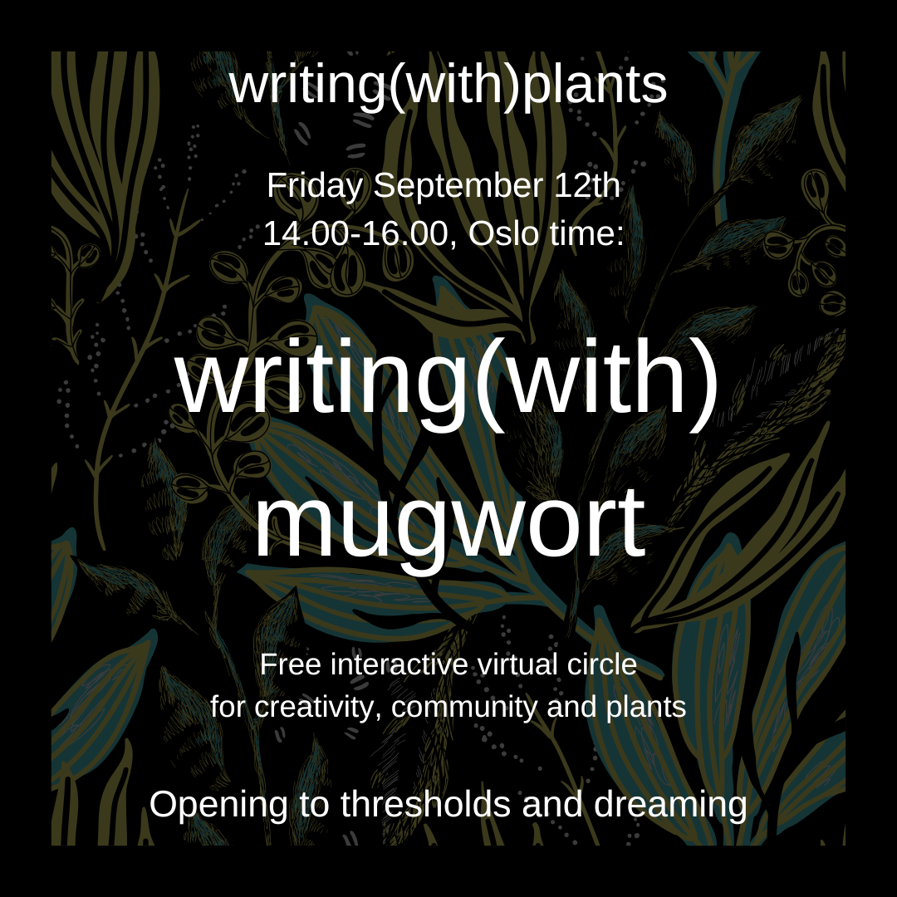
For a soft landing,
to practice deep listening,
to get in the mode
to give space to latecomers or people who want to grab some tea, water, etc…,
we always listen to a song.
Why Frozen of Madonna (around 05 minutes)?
I let wikipedia answer:
“The accompanying music video for "Frozen", directed by Chris Cunningham, was filmed at Cuddeback Lake in California, and features Madonna as an ethereal, witch-like, melancholy persona, who shapeshifts into a flock of birds and a black dog
By the mid to late 1990s, Madonna was in a more mature and introspective mood, after giving birth to her daughter Lourdes, gaining interest in Eastern mysticism and Kabbalah. (...) The singer began introspecting herself with motherhood being a "big catalyst for me. It took me on a search for answers to questions I'd never asked myself before",
Online #19

Slide 2
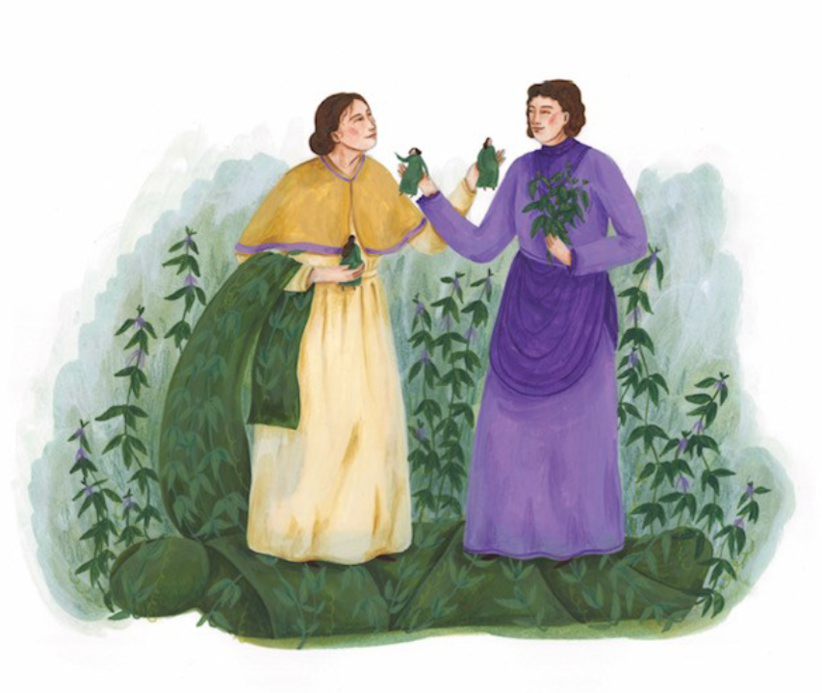
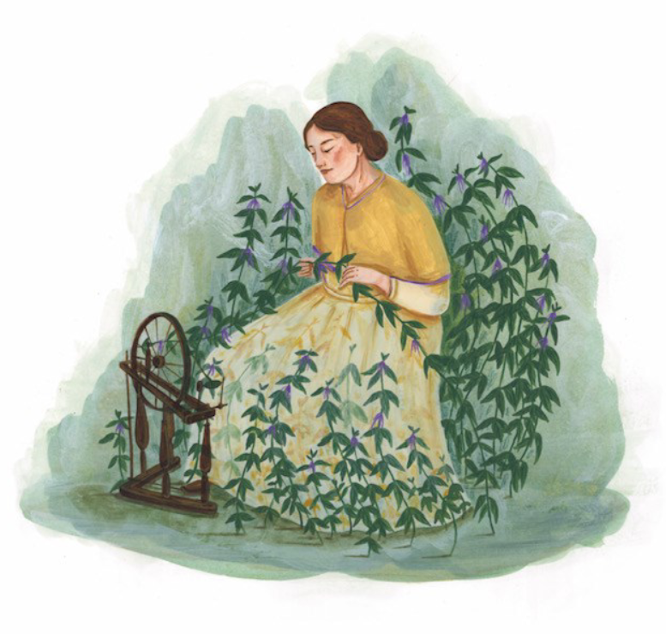
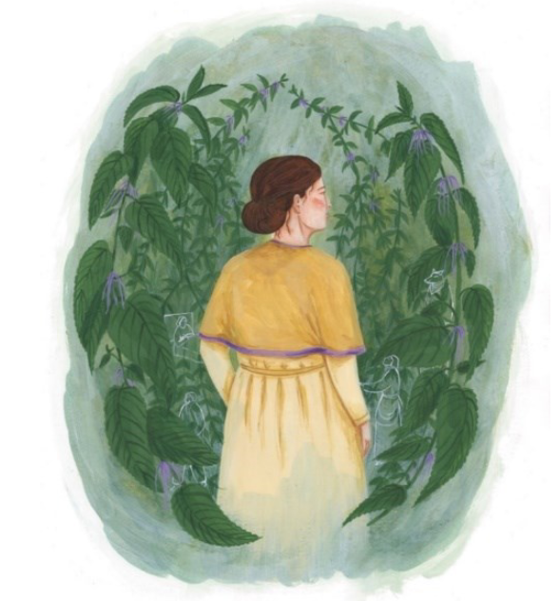
Structure of this 2 hour long session
Illustrations by Yule Hermans for short story ‘The Nettle Spinner’,
an ecofeminist retelling of a French/Flemish fairytale
Knowledge perceiving
Some theories and musings connected with writing(with)plants
Knowledge sharing
Sharing circles about the plant, the themes and the arts - DIWO
Deep listening
Knowledge making
Creative writing and arts practice - for yourself

Slide 3
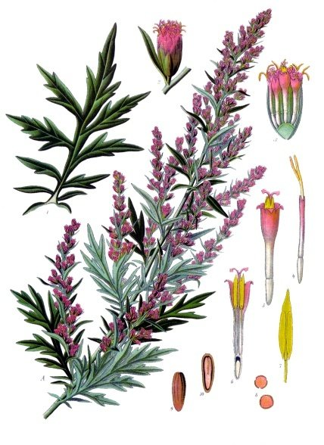
Rules and roles
Everyone is an expert and can share something.It is mutual learning space.
My role: I am a host of a virtual circle and my role is to co-create a slight structure for sharing of stories and knowledge and memories and what needs to be shared and experienced.
In the circle: Keep it simple and short (KISS). We like to honor each other’s time.
If you are finished, you say you give the talking stick to the next person.
Please try not interrupt, but if you feel you want to respond, you can share it in the chatbox.
Illustration from wikipedia

Slide 4
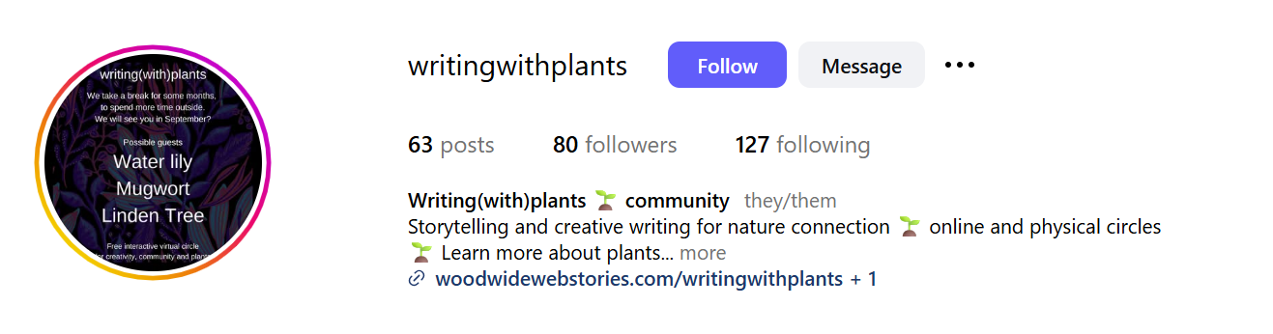
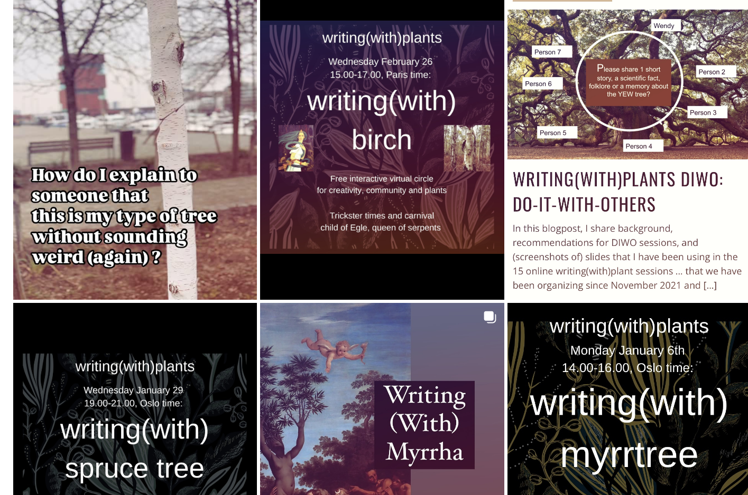
More background
I take notes. I will process this in the blogpost (announcement > transformed into a short musing) and attach the slides (open access, for free, can be used). You get an email with the blogpost link.
We publish blogs on www.woodwidewebstories.com (since 2018).
Special page: https://woodwidewebstories.com/writingwithplants/
Since late March 2025, we have a new Instagram page: @writingwithplants
Please follow this page.
Tag this page and/or invite this page for a collaboration, when you publish your own ideas around writing with plants.

Slide 5
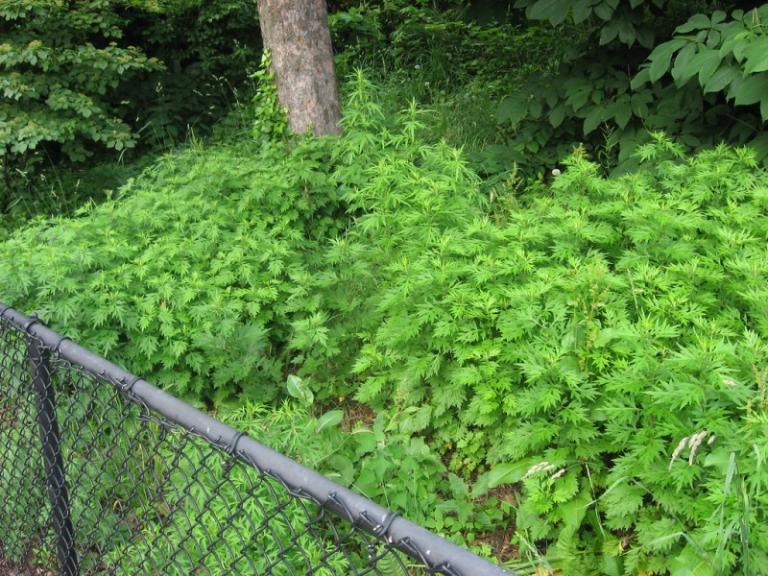
Lisa
Gabriele
Wendy
Renee
Vitalija
Valerie
Check-in (KISS):
Where are you now?
How do you feel today?
What are your expectations?
Sierra
Liene
Greta
Philip
Christina
Mania
Heide
Zofia
Marianna

Slide 6
writing(with)plants

Slide 7
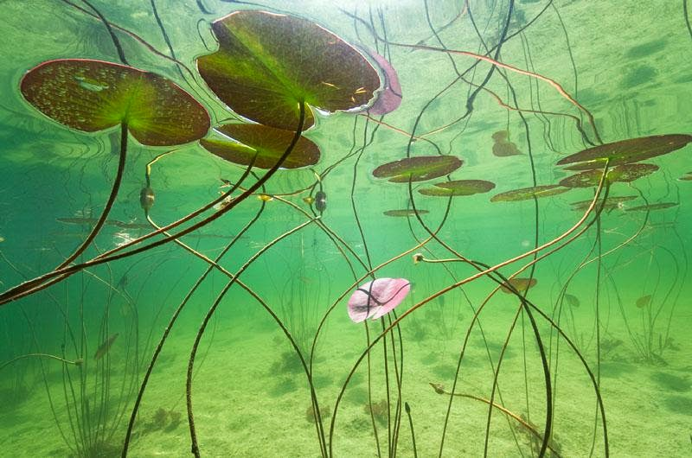
Plants can teach us a lot … about for example ecofeminism
Feminism is partly about challenging labels and categories.
A water lily challenges a lot of ideas and categories, like mobility.
They can teach us something about environmental ethics.
(Gibson and Gagliano 2017)
We will invite the water lily in autumn/migratory bird flight season 2025.

Slide 8
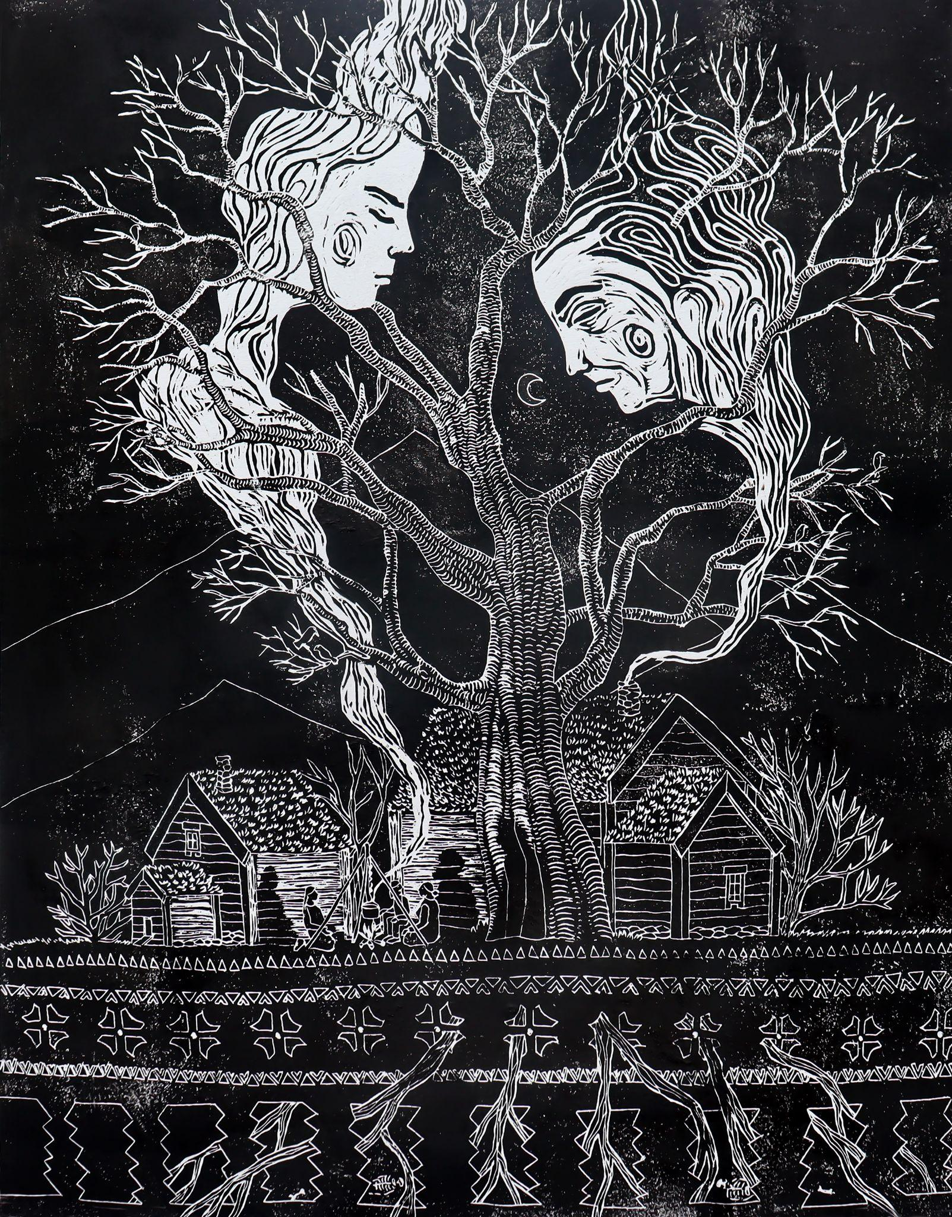
What is writing (with) plants?
Is it Phytography?
= “human writings about plant lives as well as plant writings about their own lives” (Ryan 2021).
For us, it is writing and seeing the plants as persons. Plants do not communicate in human language… and therefore observational and imagination work from our side, humans, is important.
Illustration / wood print © Laura Brusselaers for the short story ‘An Ash Tree in Os’

Slide 9
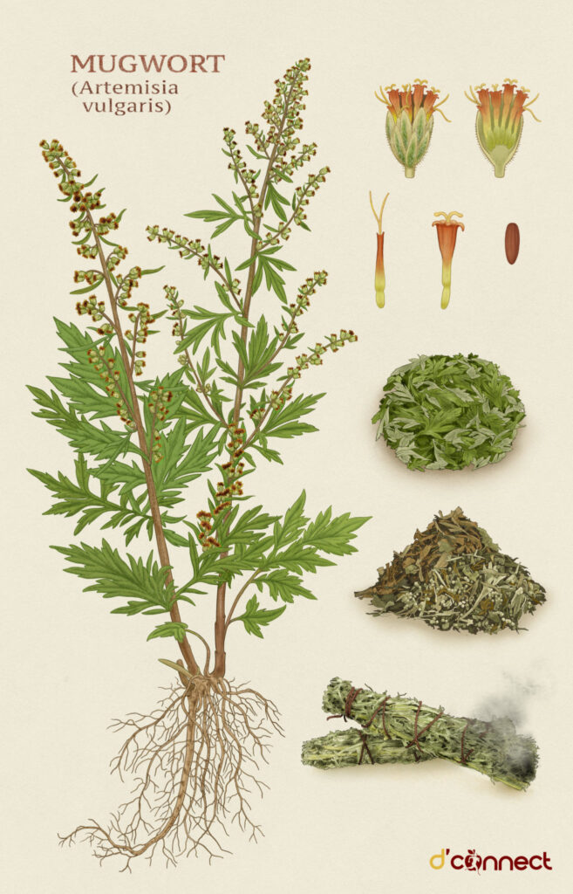
Every workshop we have another guest plant:
Previous guest plants in the ONLINE workshops:
Holly
Peonie
Knotweed
Hemp
Night Blooming Jasmine
Snowdrop
Mistletoe
Vanilla
Dandelion
Pumpkin
Ginger and cinnamon
Evening Primrose
Belladonna
Yew
Myrrh
Spruce (and snake)
Birch
Ash
And today we invite MUGWORT (Artemisia vulgaris) .

Slide 10
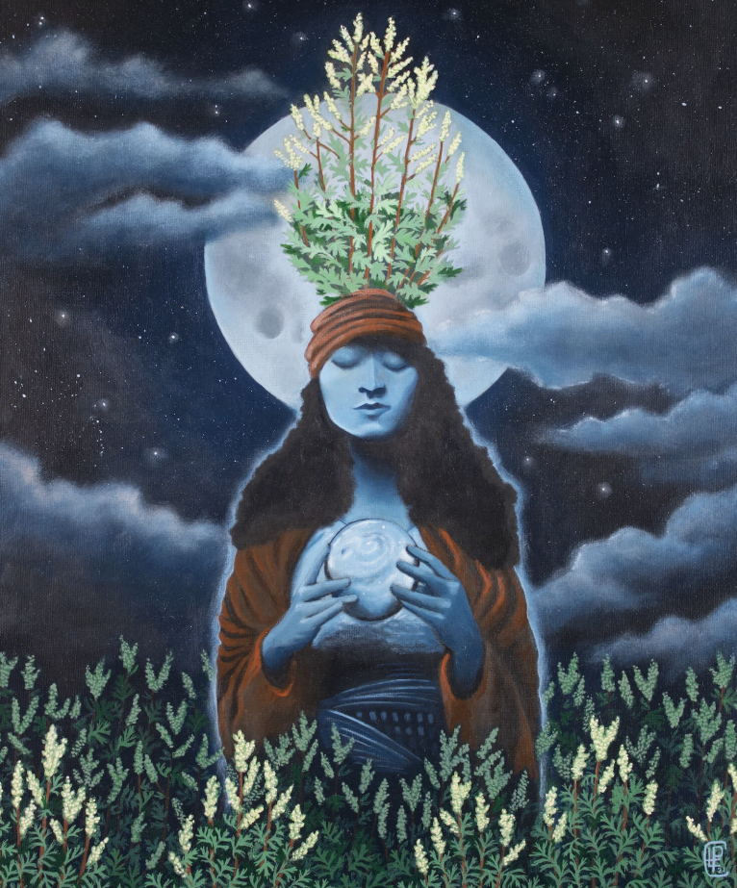
Extra challenge: avoid
anthropomorphism
… to a certain extent
Based on critical literature engaging with phytographia (Vieira, 2015; Ryan 2021; Schoene 2021; Gibson and Gagliano 2017),
the danger lies in the anthropomorphism of the plant stories, which can “embody a threat to human exceptionalism” (Gibson and Gagliano 2017),
Especially when it is used in a mindset that the ways of plants are inferior to the ways of human beings.
Finding a balance in your observational and imagination work.
The Mugwort Seer — Erica Peebus Art

Slide 11
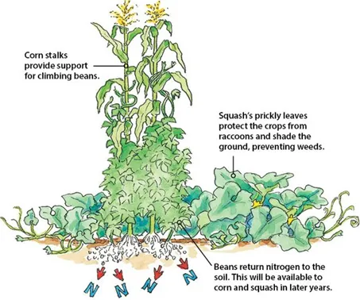
Methodological trap: is it ok to center on 1 guest plant?
Is this right when we promote relational thinking?
Plants live in symbiosis, in “guilds”
Web of interbeing
But so complex >> can be overwhelming
Centering on one place, and one plant helps
To be attentive to these relationships,
(Tsing > arts of noticing)
And focus on details is also healing (psychological practice)
We invite to be conscious of the web of interbeings
And assemblages

Slide 12
Lisa
Gabriele
Wendy
Renee
Vitalija
Valerie
Please share 1 short story, a scientific fact, folklore, recipe OR a memory about the ash tree? Or you can react to what I told you already. (KISS)
Sierra
Liene
Greta
Philip
Christina
Mania
Heide
Zofia
Marianna

Slide 13
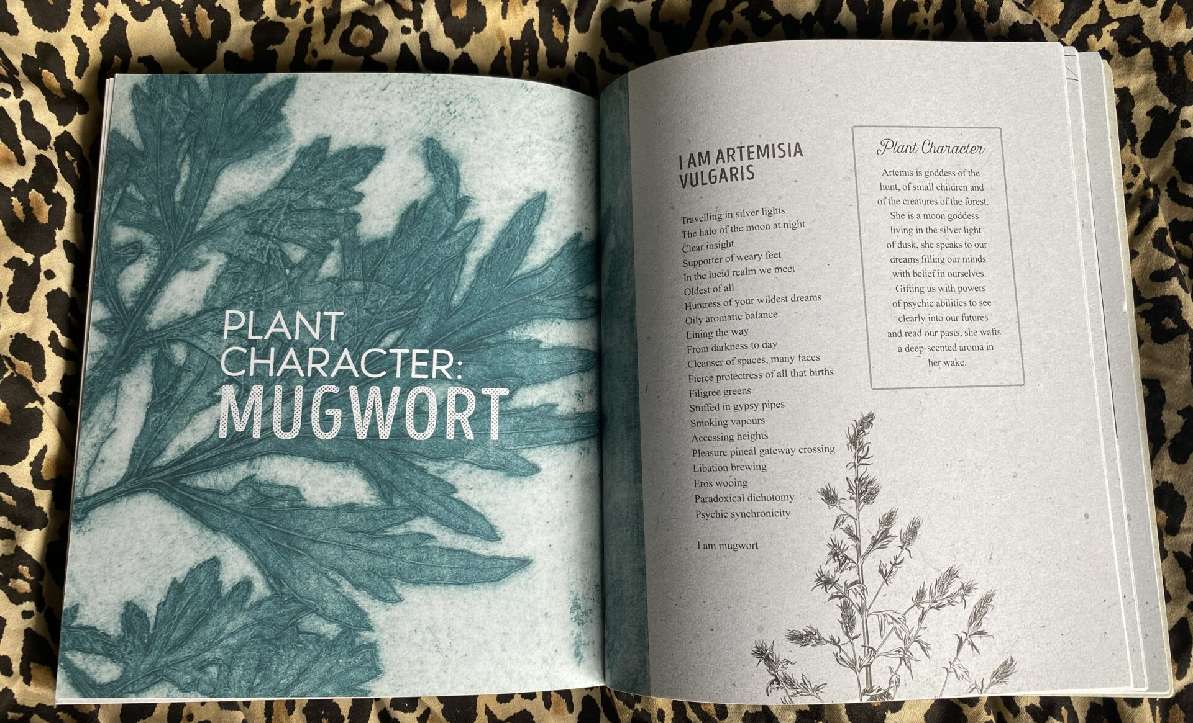
Source: The Power of Mugwort for Lucid Dreaming | Seed Sistas

Slide 14
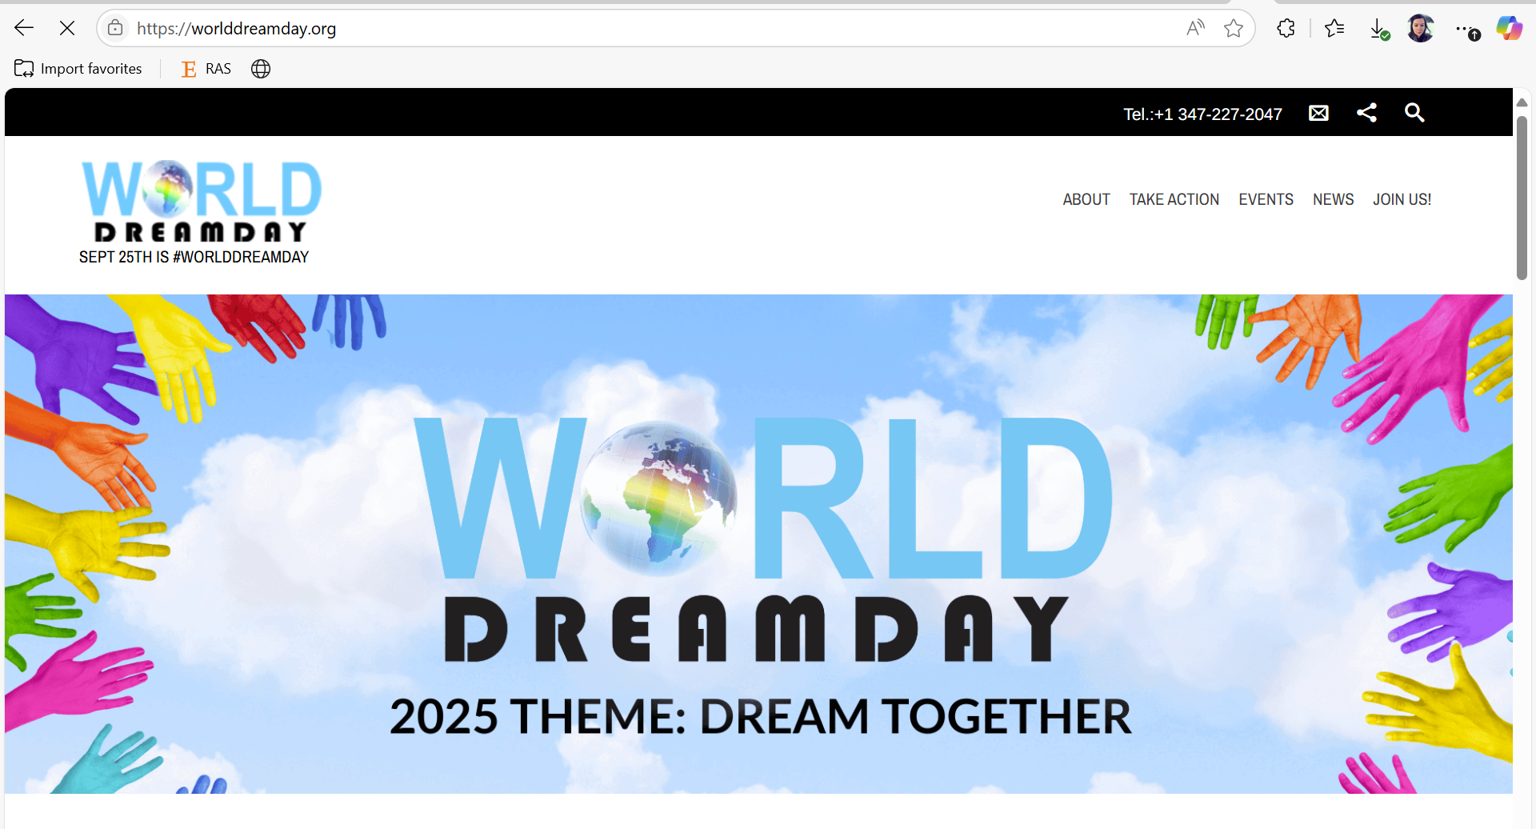

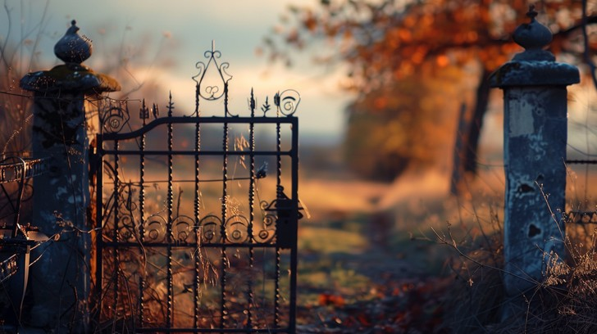

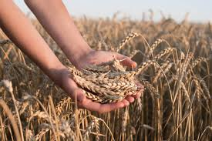
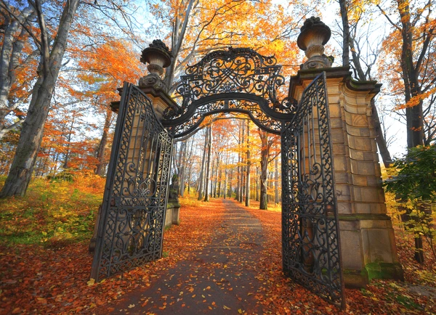
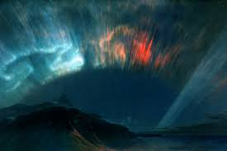
In the Northern hemisphere: SLOWING DOWN from September
to December, to the ‘thirteenth month’

Slide 15
Lisa
Gabriele
Wendy
Renee
Vitalija
Valerie
If you want to share (but not needed), is there something that you need to harvest/ close in September, so you can prepare yourself for dreaming time? (KISS)
Sierra
Liene
Greta
Philip
Christina
Mania
Heide
Zofia
Marianna

Slide 16
Creative invitation (until XX.40)
Shapeshift into MUGWORT
and write from his/her/their perspective about
… opening to thresholds and dreams.
Where are you now? How does the place look like? (season, weather…)
What are you dreaming about?
Is there something that you need to harvest/ close in September, so you can prepare yourself for dreaming time?
It can be a short story, a poem, a prayer,
An opinion piece, a sitcom scenario..
- and this can be in English, French, Northern Sámi, drawing language, bird scribbles, music symbols…

Slide 17
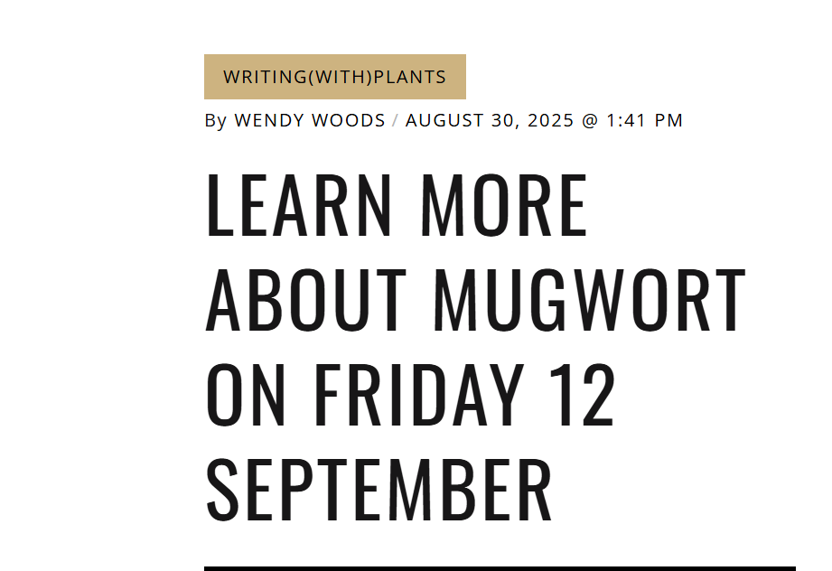
Two invitations
Online symposium (17-18 January) ECO-MYTHOLOGY 2026
Call for papers, practices, poems… got published today.
Deadline: 31 October
Learn more here:
Circle 5: Ecology of Transformative Learning Practices With/In A More-than-human World – Nordic Summer University
Please find 5-15 minutes time to leave a comment on our blogpost :
Learn more about mugwort on Friday 12 september – Stories from the Wood Wide Web
(This will be updated, with a download link of the slides)

Slide 18
Lisa
Gabriele
Wendy
Renee
Vitalija
Valerie
Greta
What do you want to share with the group (reflection, your story, poem, or just a word of gratitude towards mugwort, the circle, yourself…) so you feel some closure. (KISS)
Sierra
Liene
Greta
Philip
Christina
Mania
Heide
Zofia
Marianna

