Slide 1
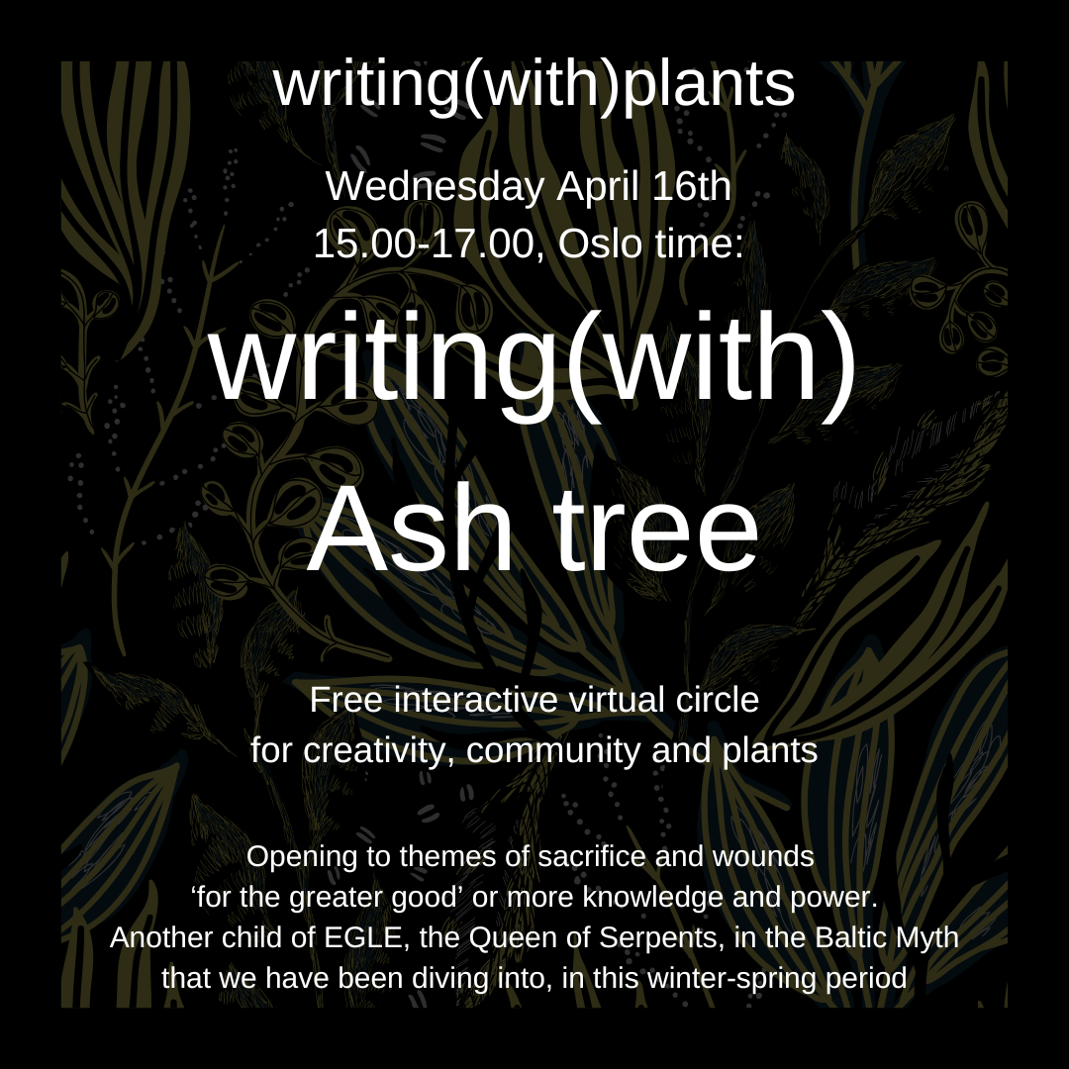
Or
writing(with) ASH
How do we experience and sacrifice and begin to reclaim it?
When is sacrifice a story of loss or initiation?
We invite Ash in close and ask - what needs to be sacrificed before a rebirth?
#18

Slide 2
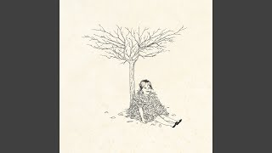
For a soft landing, to practice deep listening and to give space to latecomers, we always listen to a song for 2-4 minutes.
We invite Ash in close and ask
How do we experience and sacrifice and begin to reclaim it?
When is sacrifice a story of loss or initiation?
What needs to be sacrificed before a rebirth?

Slide 3
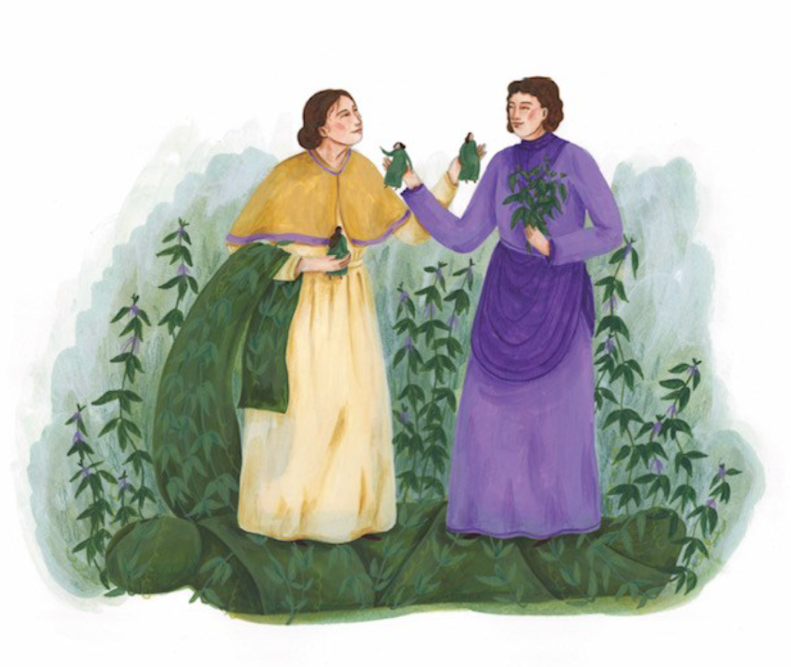
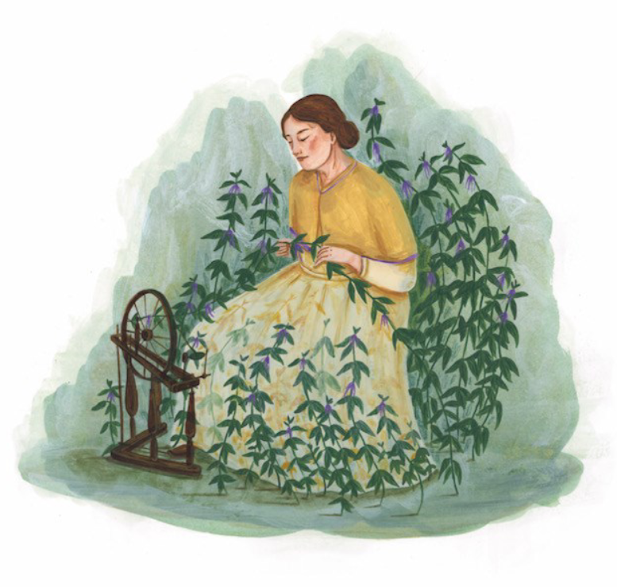
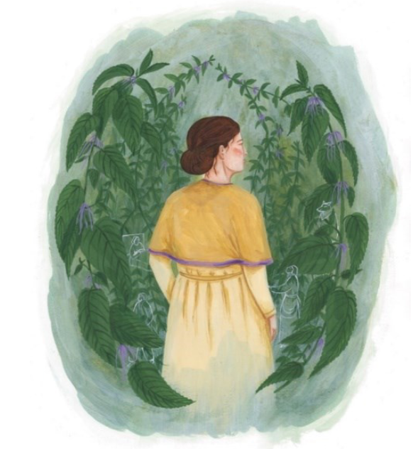
Structure of this 2 hour long session
Illustrations by Yule Hermans for short story ‘The Nettle Spinner’,
an ecofeminist retelling of a French/Flemish fairytale
Knowledge perceiving
Some theories and musings connected with writing(with)plants
Knowledge sharing
Sharing circles about the plant, the themes and the arts - DIWO
Deep listening
Knowledge making
Creative writing and arts practice - for yourself

Slide 4
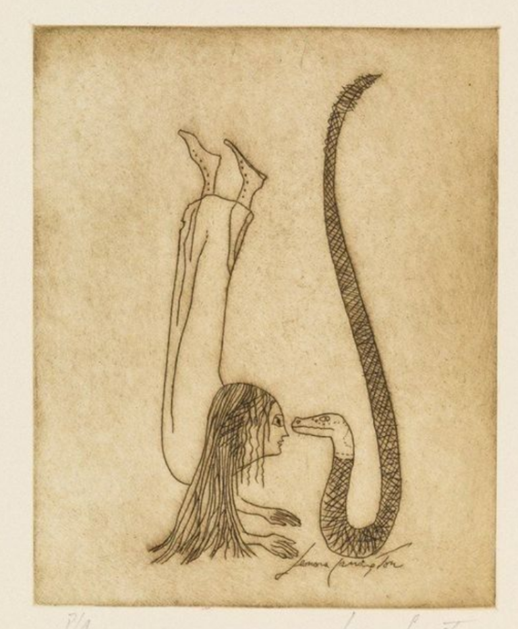
Rules and roles
Everyone is an expert and can share something.It is mutual learning space.
My role: I am a host of a virtual circle and my role is to co-create a slight structure for sharing of stories and knowledge and memories and what needs to be shared and experienced.
In the circle: Keep it short. We like to honor each other’s time.
If you are finished, you say you give the talking stick to the next person.
Please try not interrupt, but if you feel you want to respond, you can share it in the chatbox.
Illustration by LEONORA CARRINGTON (1917-2011) // Una Vida Surrealista // Etching and Aquatint in Sepia // Drawn between 1994-1997

Slide 5

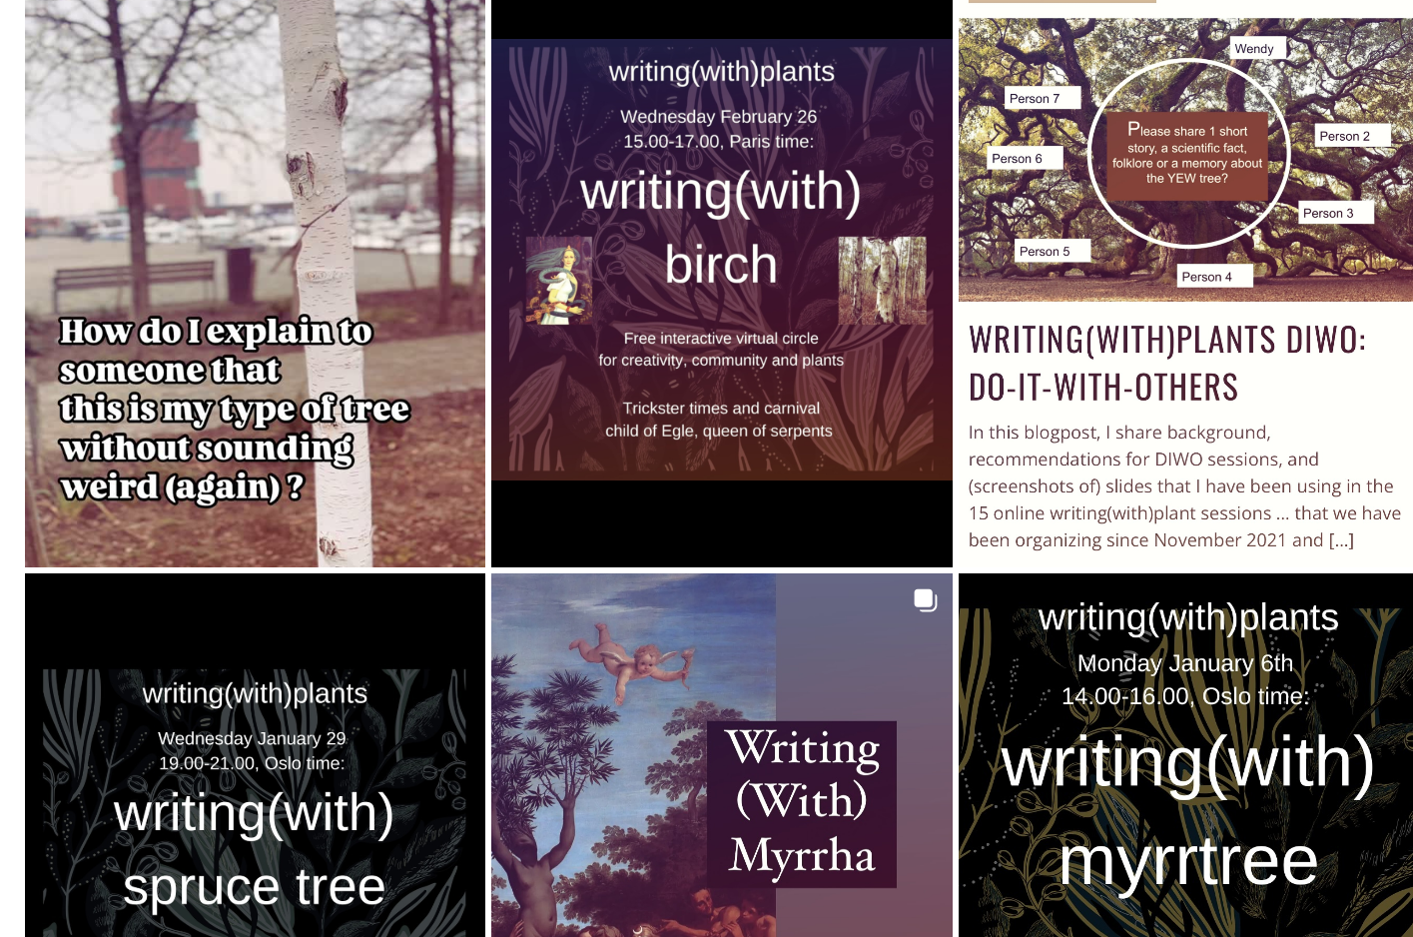
More background
I do not record the session, but I take notes.
We publish blogs on www.woodwidewebstories.com (since 2018).
Special page: https://woodwidewebstories.com/writingwithplants/
Since late March 2025, we have a new Instagram page: @writingwithplants
Please follow this page.
Tag this page and/or invite this page for a collaboration, when you publish your own ideas around writing with plants.

Slide 6
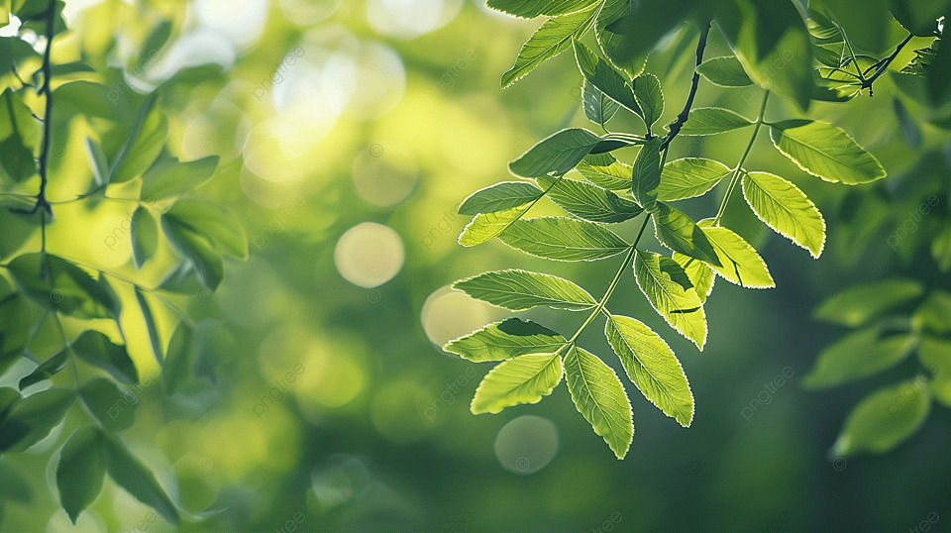
Wendy
participant
Check-in:
Where are you now?
How do you feel today?
What are your expectations?
participant
participant
participant

Slide 7
writing(with)plants

Slide 8
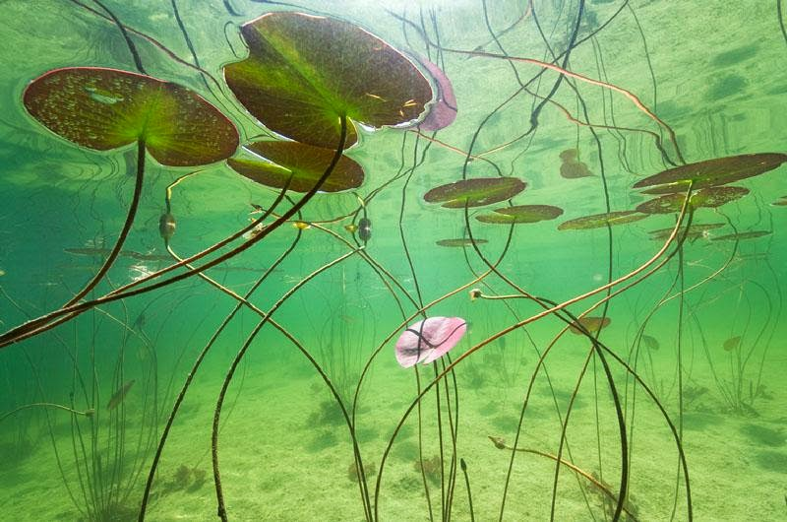
Plants can teach us a lot … about for example ecofeminism
Feminism is partly about challenging labels and categories.
A water lily challenges a lot of ideas and categories, like mobility.
They can teach us something about environmental ethics.
(Gibson and Gagliano 2017)
We will invite the water lily in autumn/migratory bird flight season 2025.

Slide 9
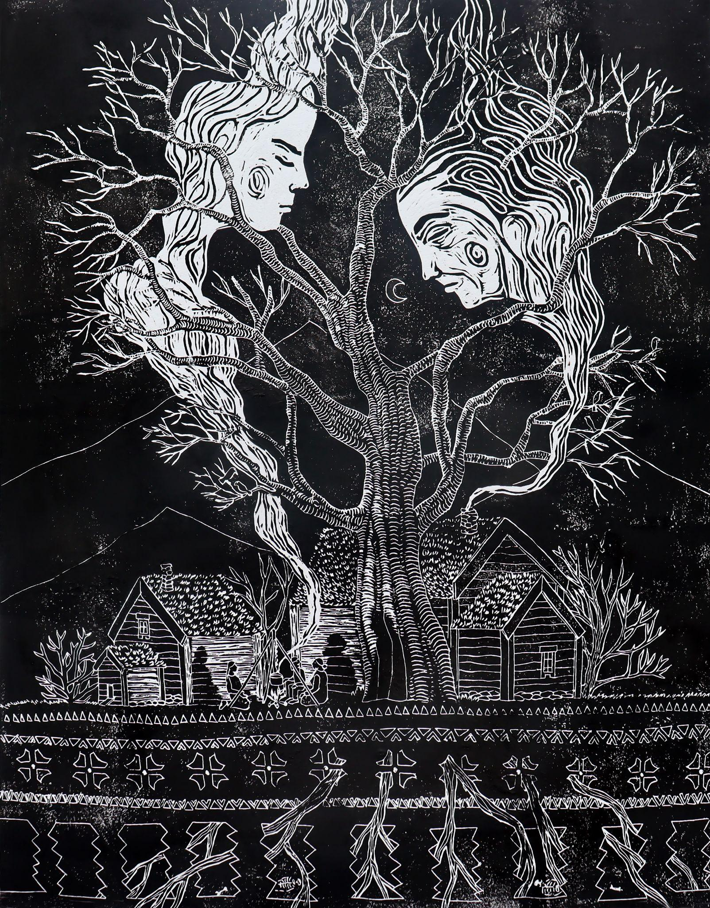
What is writing (with) plants?
Is it Phytography?
= “human writings about plant lives as well as plant writings about their own lives” (Ryan 2021).
For us, it is writing and seeing the plants as persons. Plants do not communicate in human language… and therefore observational and imagination work from our side, humans, is important.
Illustration / wood print © Laura Brusselaers for the short story ‘An Ash Tree in Os’

Slide 10
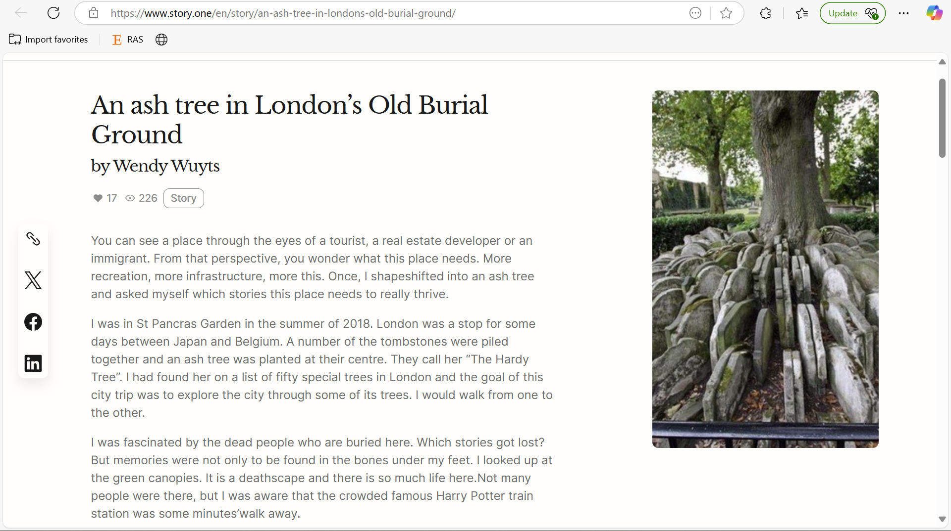

Slide 11
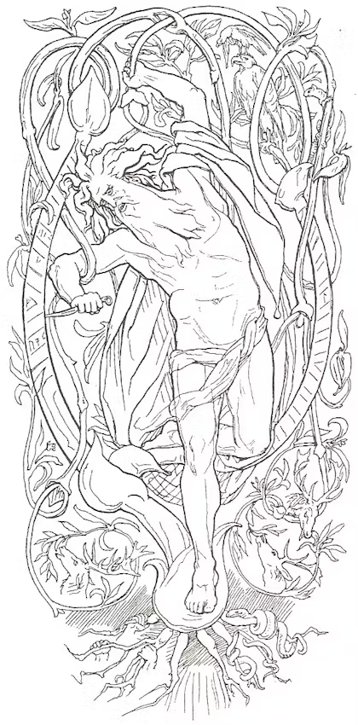
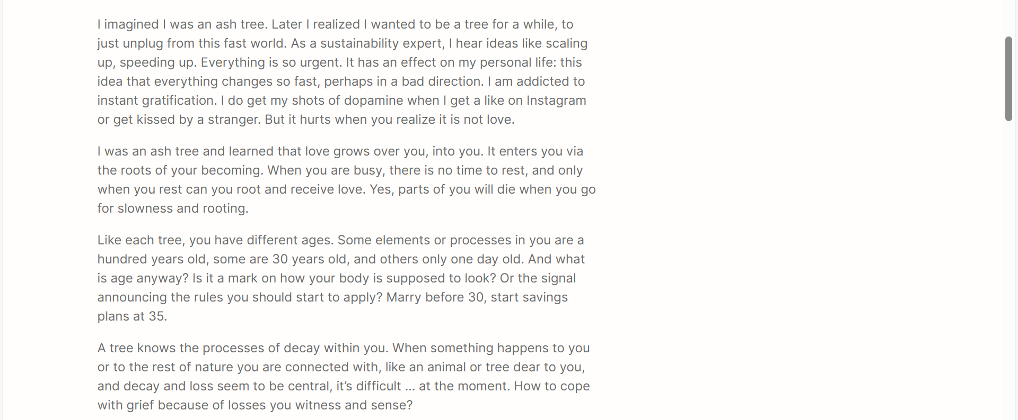
Odin sacrifices himself by hanging from the world tree Yggdrasil, the sacred ASH TREE in Norwegian mythology, as attested in Hávamál. Illustration from Karl Gjellerup’s Den ældre Eddas Gudesange (1895)

Slide 12
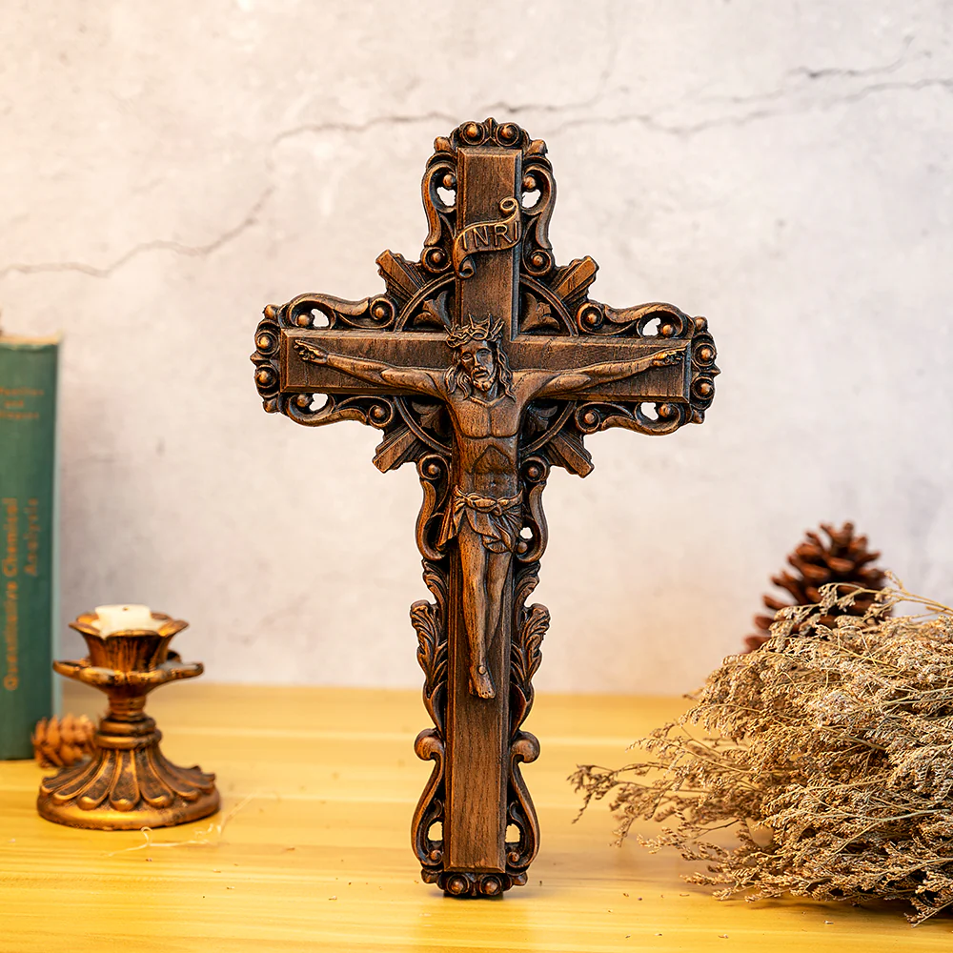
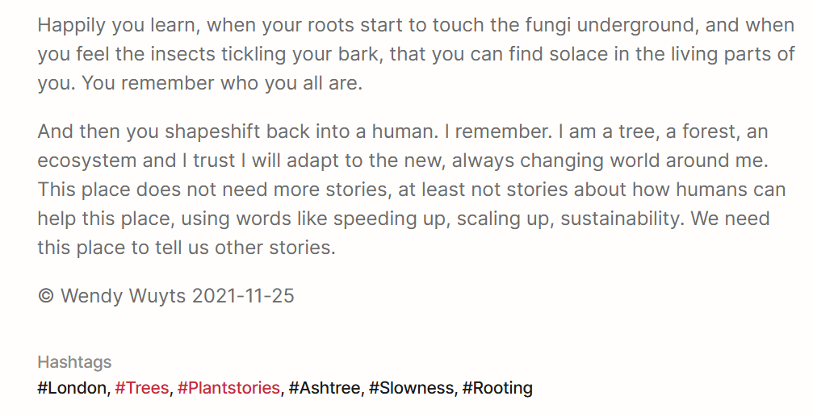
A crucifix made from ash wood

Slide 13
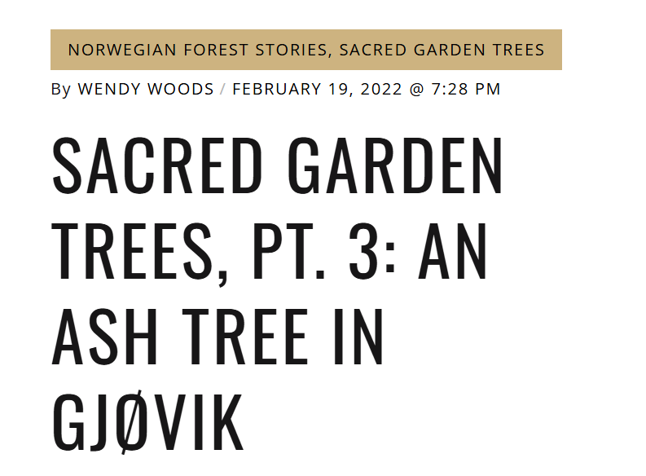
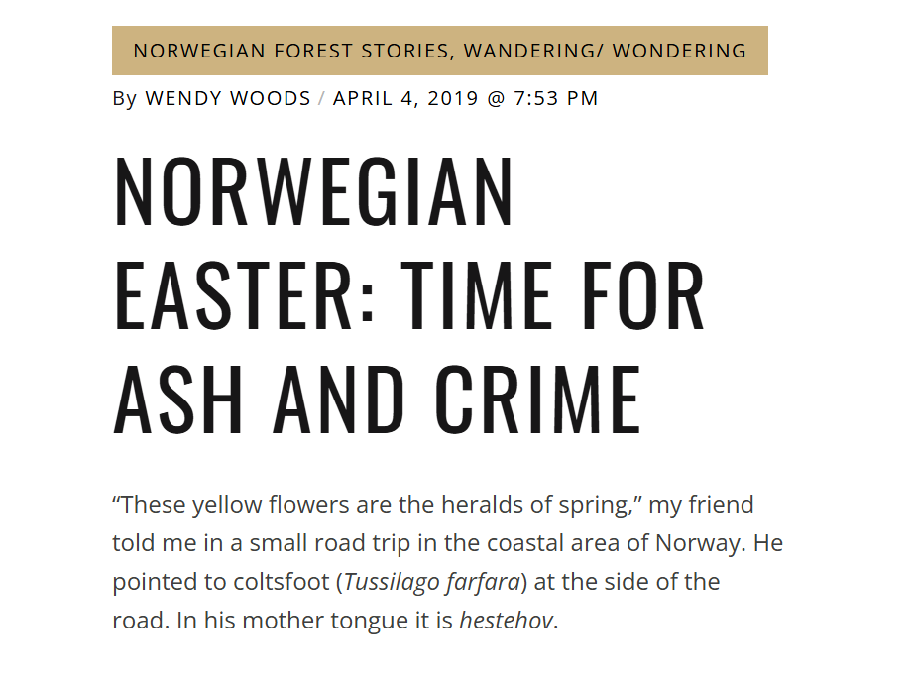
As someone who is rooting in Norway, the ash tree - unsurprisingly - inspired some blog posts and other creative work.

Slide 14
In 2024, EcoZona published a fiction story that I wrote.
Again, I foregrounded the Ash Tree and worked with themes of care and contamination and loss and grief.
Illustration / wood print © Laura Brusselaers for the short story ‘An Ash Tree in Os’

Slide 15
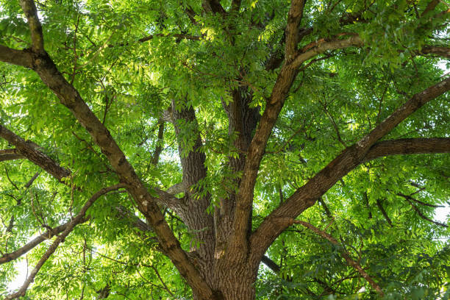
Every workshop we have another guest plant:
Previous guest plants:
Holly
Peonie
Knotweed
Hemp
Night Blooming Jasmine
Snowdrop
Mistletoe
Vanilla
Dandelion
Pumpkin
Ginger and cinnamon
Evening Primrose
Belladonna
Yew
Myrrh
Spruce (and snake)
Birch
And today we invite the ASH TREE.

Slide 16
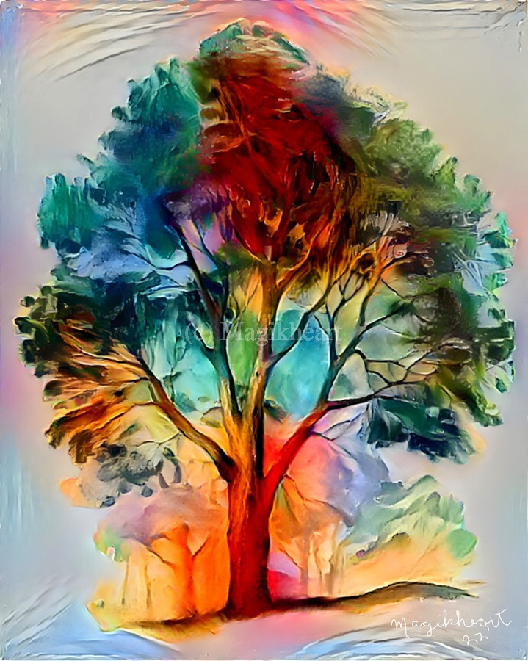
Extra challenge: avoid
anthropomorphism
… to a certain extent
Based on critical literature engaging with phytographia (Vieira, 2015; Ryan 2021; Schoene 2021; Gibson and Gagliano 2017),
the danger lies in the anthropomorphism of the plant stories, which can “embody a threat to human exceptionalism” (Gibson and Gagliano 2017),
Especially when it is used in a mindset that the ways of plants are inferior to the ways of human beings.
Finding a balance in your observational and imagination work.
THE SPIRIT OF THE WHITE ASH TREE - by Magikheart

Slide 17
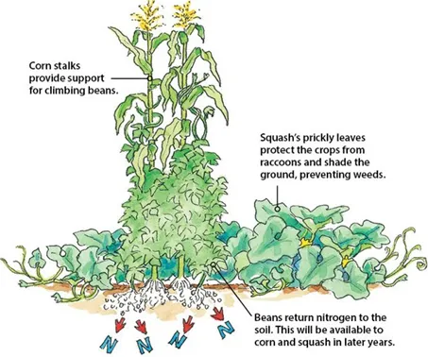
Methodological trap: is it ok to center on 1 guest plant?
Is this right when we promote relational thinking?
Plants live in symbiosis, in “guilds”
Web of interbeing
But so complex >> can be overwhelming
Centering on one place, and one plant helps
To be attentive to these relationships,
(Tsing > arts of noticing)
And focus on details is also healing (psychological practice)
We invite to be conscious of the web of interbeings
And assemblages

Slide 18
Wendy
participant
Please share 1 short story, a scientific fact, folklore, recipe OR a memory about the ash tree?
Or you can react to what I told you already.
participant
participant
participant

Slide 19
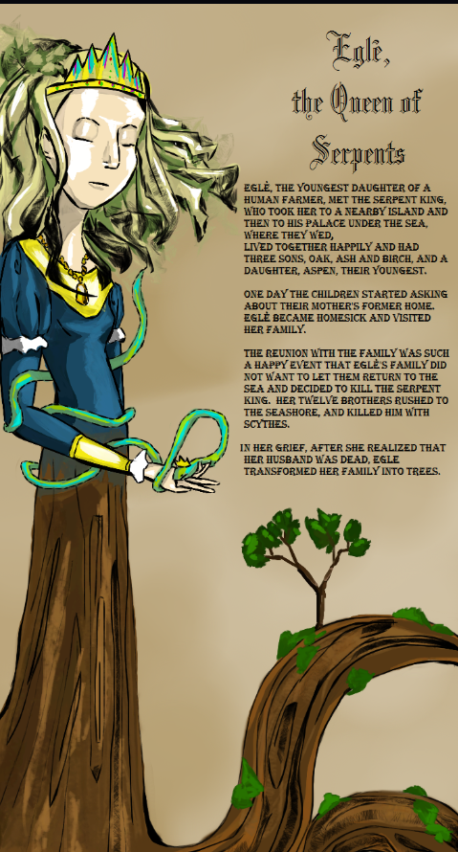
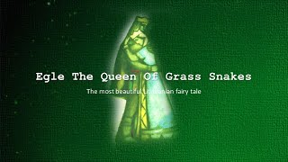
In the Baltic Sea region: Egle (= Spruce)
Eglė had three sons: Ąžuolas (Oak), Uosis (Ash) and Beržas (Birch) and one daughter – Drebulė (Aspen), who was her youngest.
The myth/folktale does not tell much about Uosis = Ash. I use these sessions to imagine/deepen the characters.
Egle the Queen of Serpents by TheSechelf on DeviantArt

Slide 20
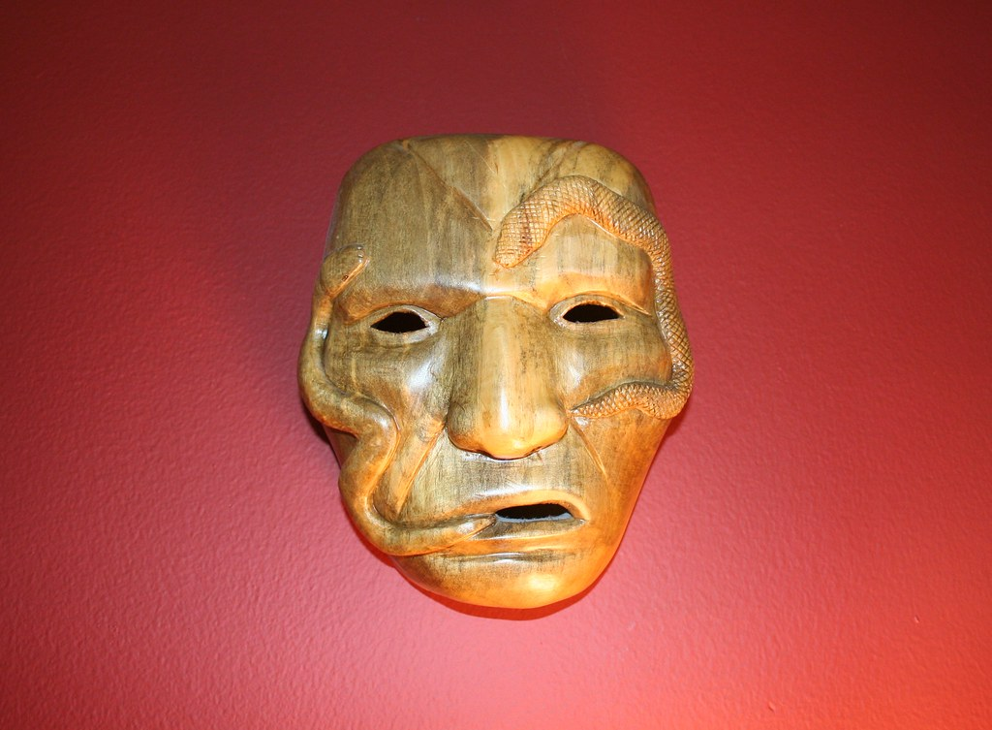
Cherokee Healing Mask
This is made from an ash tree by S. Tooni from North Carolina
Photograph: J Poole

Slide 21
ASH - stories
In Norse mythology, ash was the 'Tree of Life' and the first man on Earth was said to have come from an ash tree.
Even today it is sometimes known as the 'Venus of the woods'.
In Britain, druids regarded the ash as sacred and their wands were often made of ash because of its straight grain.
In ACOTAR, the famous fantasy series, fairies can be killed with ash wood.
In Greek mythology, Melia or Melie (Ancient Greek Μελία, Μελίη) was the name of several figures. The name Melia comes from μελία, the ancient Greek word for ash-tree. There were several other nymphs (or possible nymphs) named Melia, not necessarily associated with trees.

Slide 22
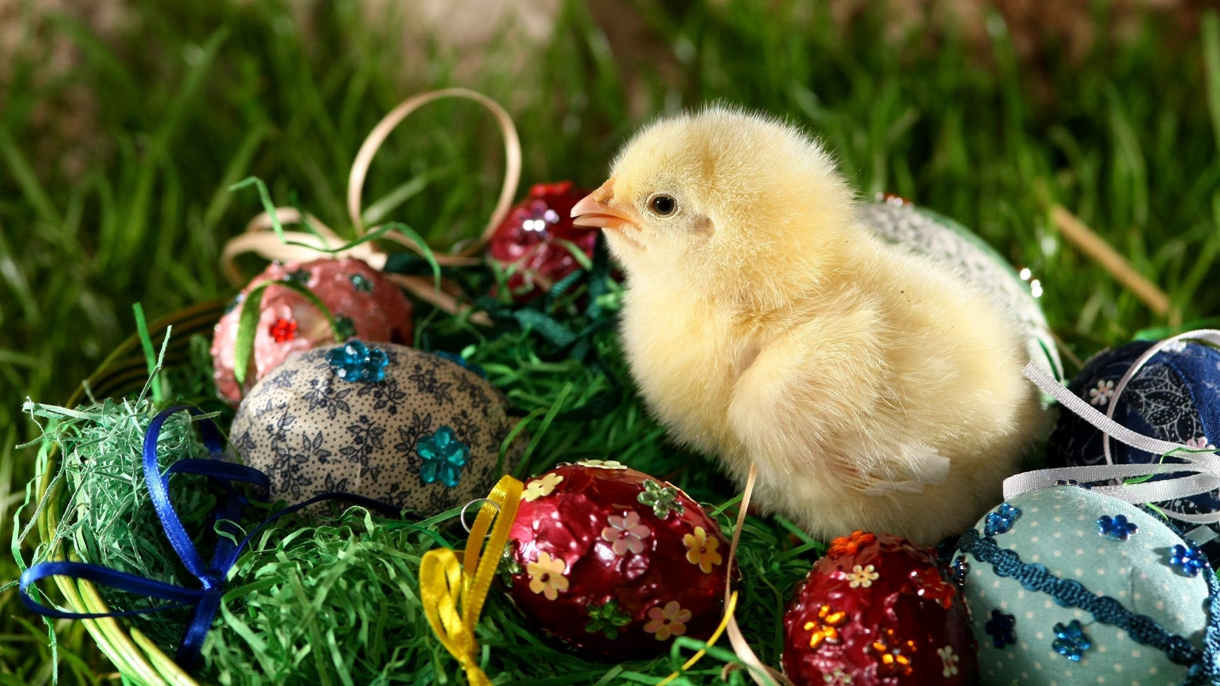

Slide 23
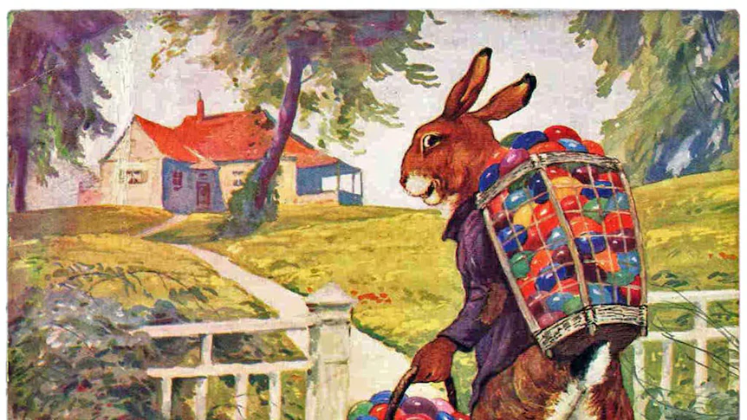

Slide 24
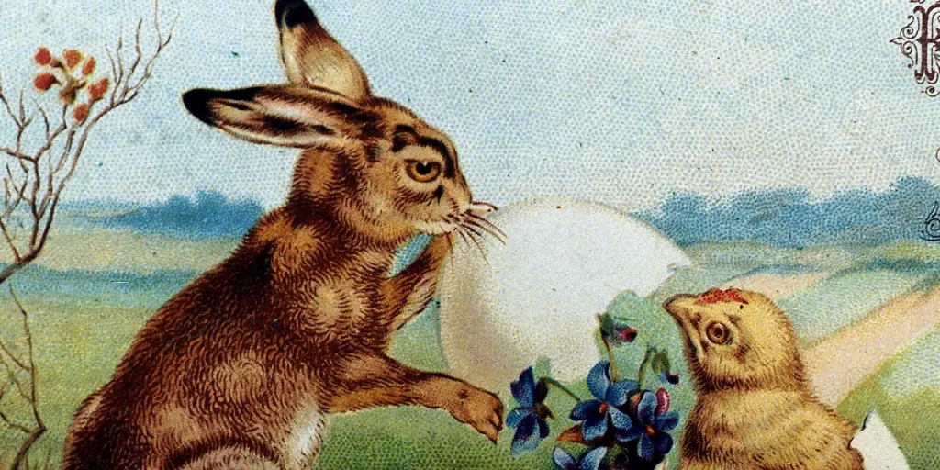

Slide 25
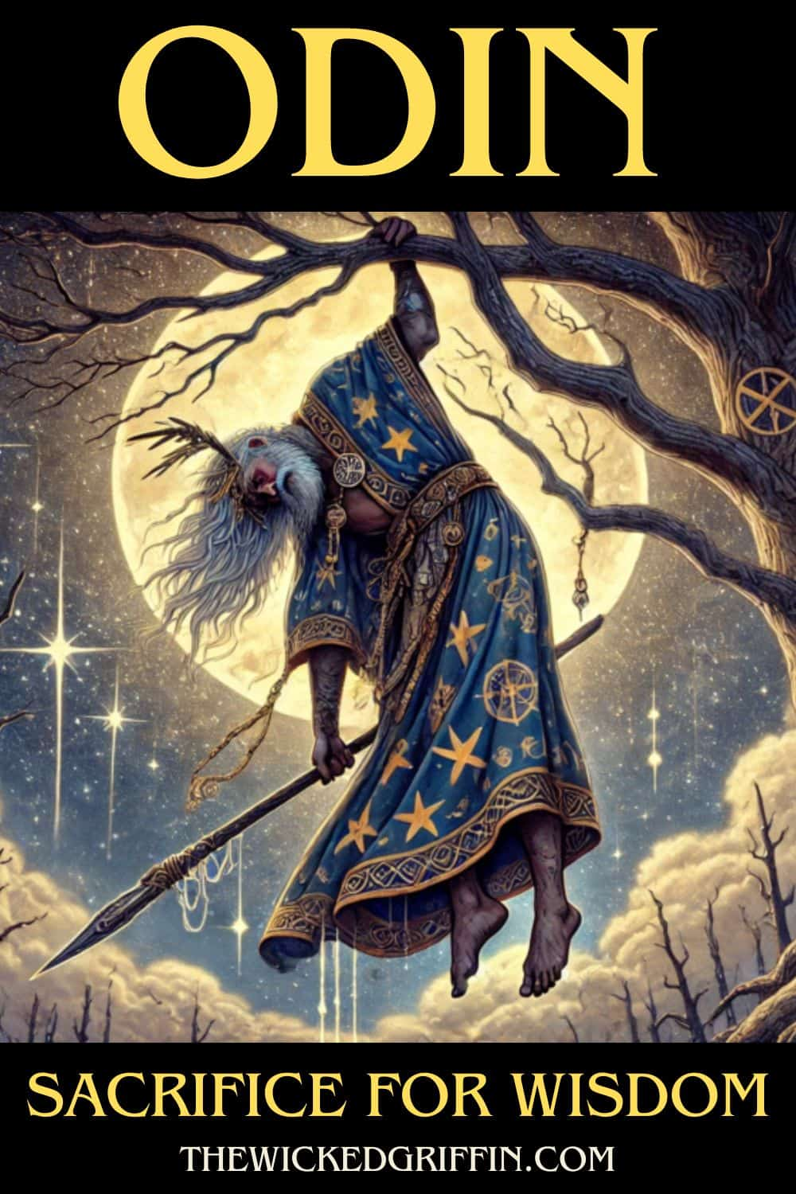
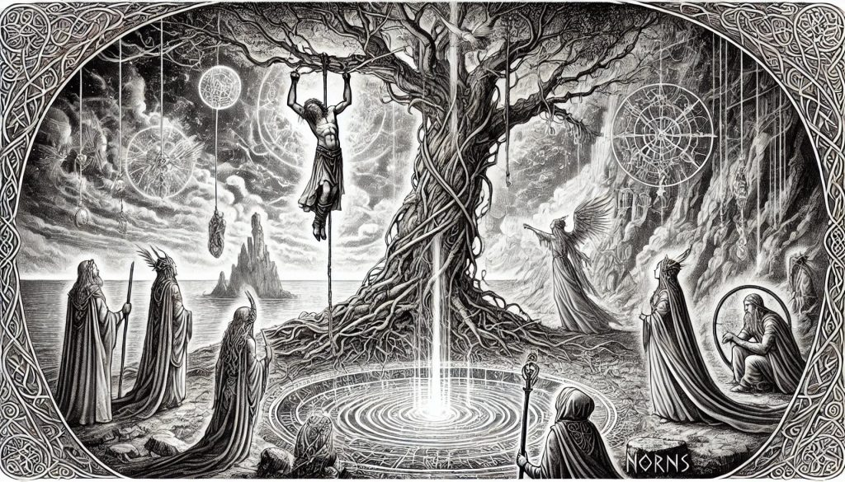
The runes - wisdom (?)

Slide 26
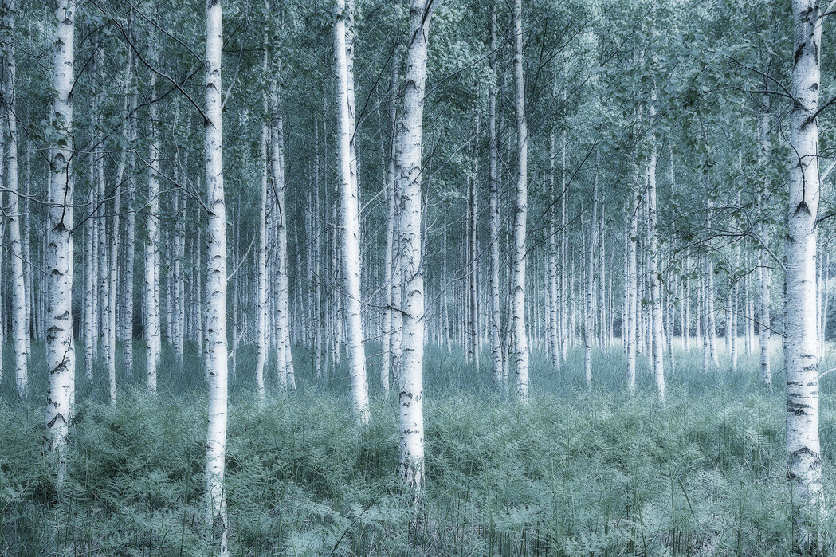
Wendy
participant
When is sacrifice a story of loss?
When is sacrifice a story of initiation?
participant
participant
participant

Slide 27
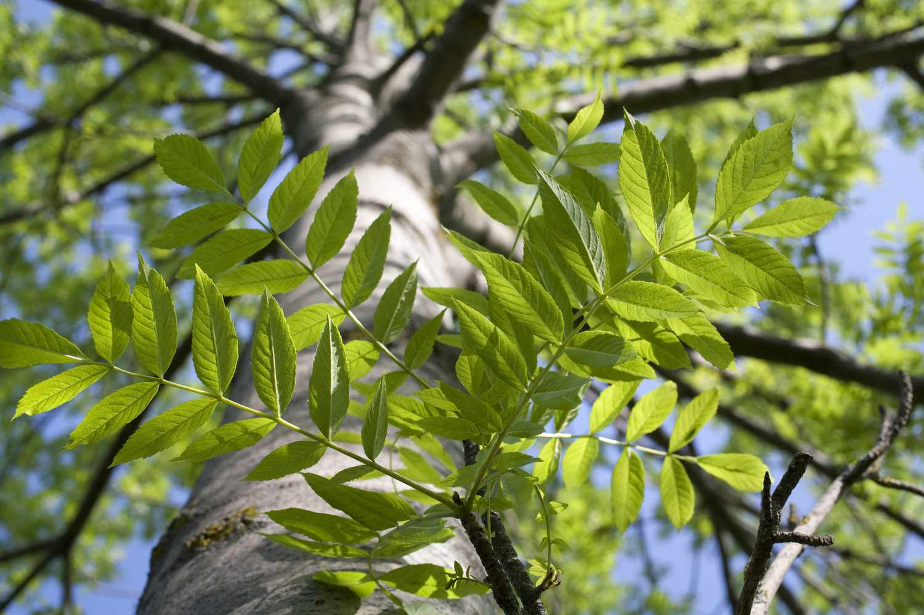
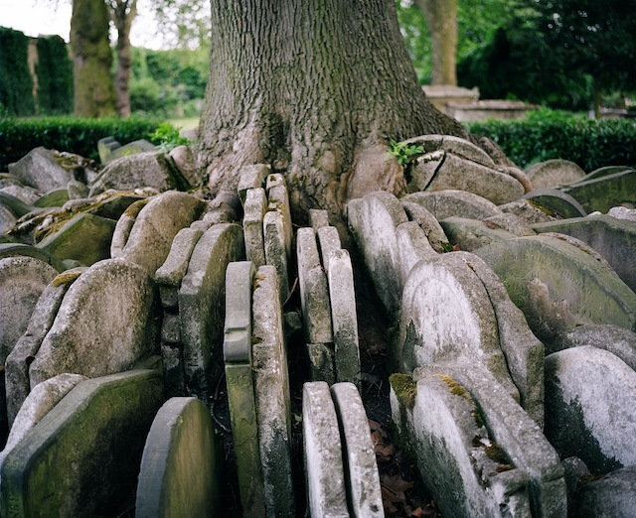
Creative invitation (until XX.45)
Shapeshift into ASH
and write from his/her/their perspective about
… sacrifice and rebirth
Where are you now?
How do we experience and sacrifice?
How do we begin to reclaim it?
When is sacrifice a story of loss? When is it a story of initiation?
What needs to be sacrificed before a rebirth?
It can be a short story, a poem, a prayer,
An opinion piece, a sitcom scenario..
- and this can be in English, French, Northern Sámi, drawing language, bird scribbles, music symbols…

